Slide 1
Attendance Application For Iglesia Vida
By: Dino Henriquez Rios
Cameron Harvey

Slide 2
Web Application Goals
Visitor attendance.
The number of people who attended will be manually counted and entered into the web app.
First time visitor information.
This includes names, phone numbers, emails, addresses, info on how the person heard about the church, a survey, and follow up (text, notification).
Baptism records.
The date the baptism took place should be logged along with the recipient’s name.

Slide 3
Web Application Goals (cont.)
Administrative roles.
Ability for users to login as an administrator with access to the database.
Automated reports.
Weekly & monthly reports delivered by email.
Reports should include line and/or bar graph analysis.
Machine learning.
To be determined at a later date.

Slide 4
Task Assignments
Cameron -
Front-End & Back-End
Dino -
Database & Back-End

Slide 5
Front-End
Login page for users to sign in to the web app.
Separate access for admins & normal users.
Page to keep track of attendance for each event.
Possibly by using a calendar.
Page with a list of members and their information.
Include option to add new members.

Slide 6
Back-End
Web app created using React JavaScript.
Allow communication between the web app & database.
Must link Cassandra with React.
Functionality to send out automated emails.

Slide 7
Access & Privileges
Authentication -
Users may login using email and password. (?)
Authorization -
Administrators may assign administrative roles to other users. (?)

Slide 8
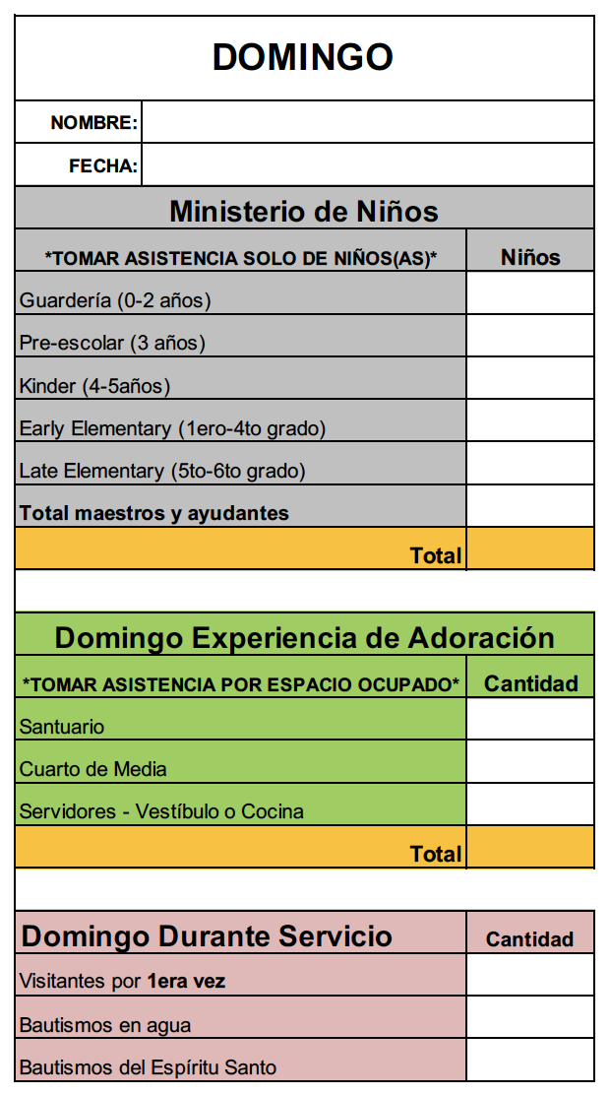
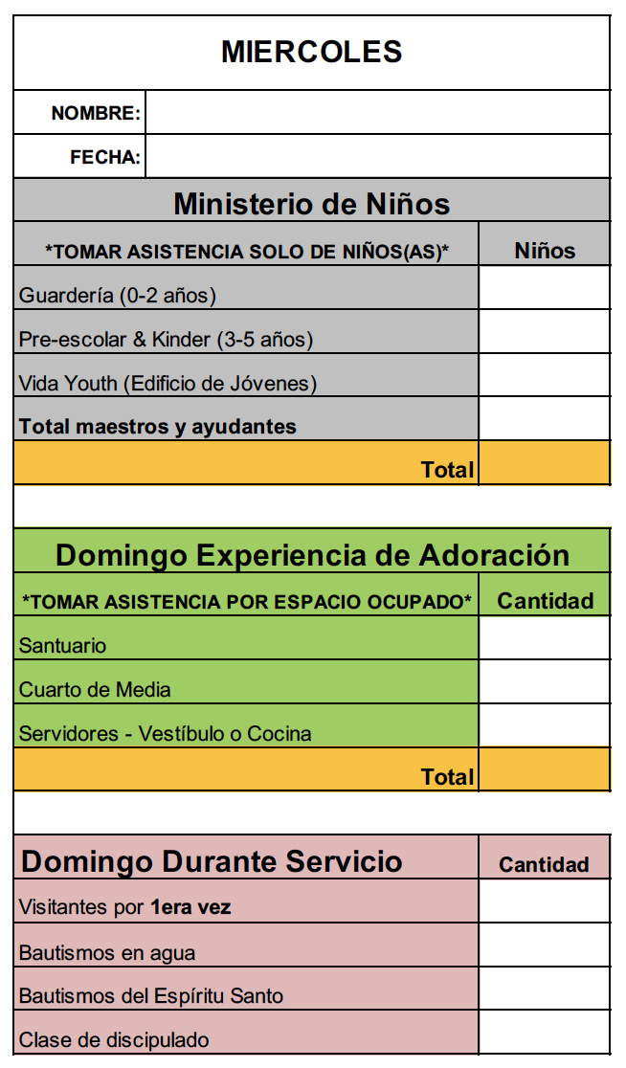
Customer’s Current Attendance Method
Currently the customer writes down all the information on a PDF file for Sunday and Wednesday:

Slide 9
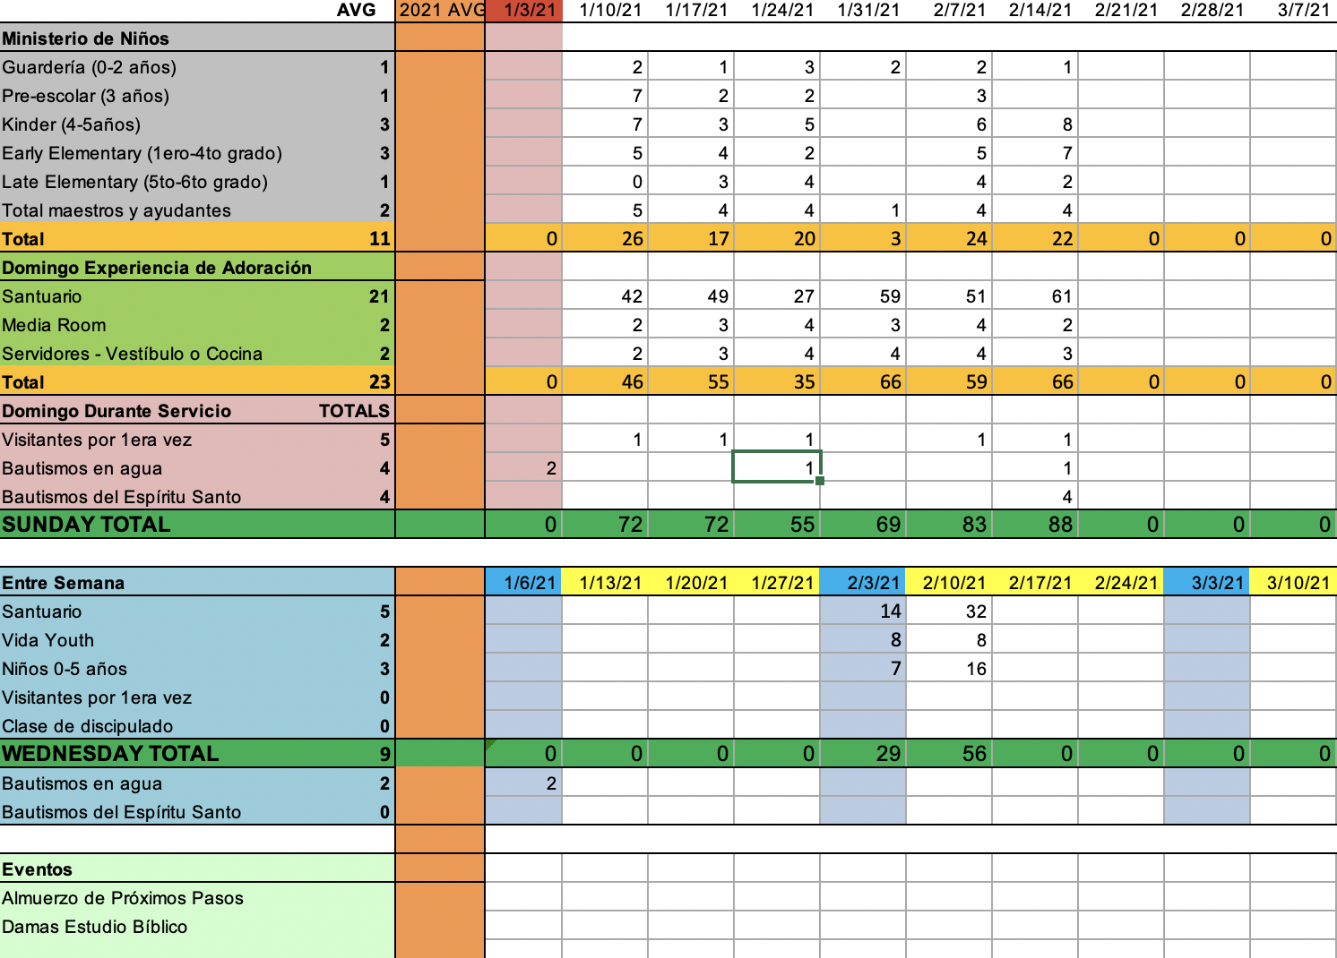
Customer’s Current Attendance Method cont...
The customer then enters all the information into a spreadsheet through a manual process:

Slide 10
Sunday Service Attendance
Ushers
(Update privileges)
Wednesday Service Attendance
LOGIN
Visitor’s Information
Admin
(CRUD Privileges)
Member’s Information

Slide 11
Table Creation samples:
CREATE TABLE sunday(
column1 id int PRIMARYKEY,
column2 usher_name text,
column3 age varint.
)
CREATE TABLE sunday_school(
column1 id int PRIMARYKEY,
column2 nursery varint,
column3 pre_school varint,
column4 kinder var int,
column5 early_elementary varint,
column6 late lementary varint,
column7 teach_assist varint.
)
CREATE TABLE sunday_service(
column1 id int PRIMARYKEY,
column2 sanctuary varint,
column3 media_room varint,
column4 ushers.
)
CREATE TABLE sunday_visit_bapt(
column1 id int PRIMARYKEY,
column2 first_visitors varint,
column3 water_bapt varint,
column4 holy_g_bapt varint.
)

Slide 12
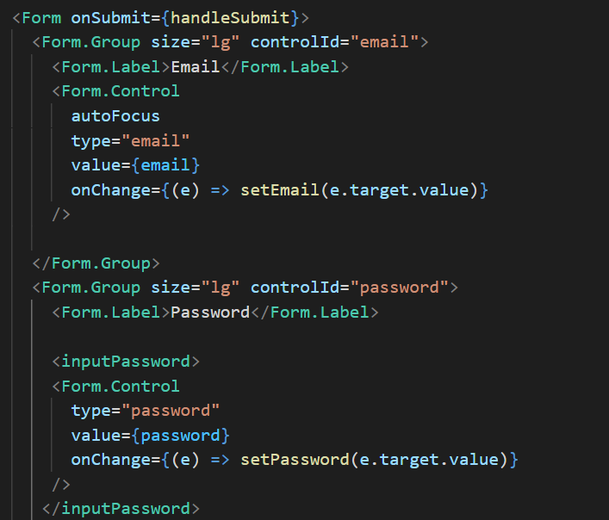
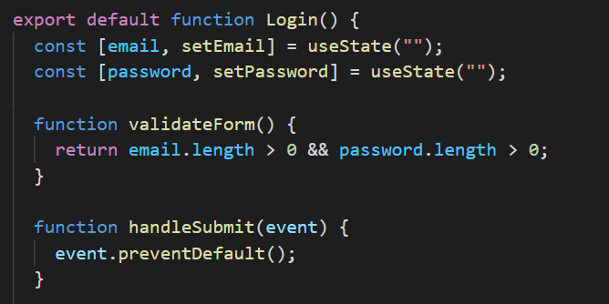
Code Samples
Login form :

Slide 13
Spring Semester Goals
Week (Feb 22nd – Feb 26th)
Goals:
General: Get the Front-End, Back-End and Database to communicate with each other.
Front-End:
-Login page
-Start developing the other pages
-Have Front-end communicate with server
Back-End:
-Create a server
-Have a server communicating with database
Database:
-Have a database communicating with server
-Design the data relation among the different data components
-Create all the tables necessary to hold all the data

Slide 14
Week (Mar 1st – Mar 5th)
Goals:
General: Meet with the customer to get their feedback
Front-End:
-Meet the customer feedback
Back-End:
-Adjust any to issues encountered by the customer
Database:
-Test that the data is consistent and reliable after F-E and B-E adjustments

Slide 15
Week (Mar 8th – Mar 12th)
Goals:
Front-End:
-‘Sunday Attendance’ page
-‘Wednesday Attendance’ page
Back-End:
-Data’s Security and Privacy
-Reports and graphs

Slide 16
Week (Mar 15th – Mar 19th)
Goals:
Front-End:
-Visitor Info page
-Member’s Info page
Back-End:
-Add Machine Learning component to reports and graphs
Database:

Slide 17
Week (Mar 22nd – Mar 26th)
Goals:
General: Meet with the customer to get their feedback
Front-End:
-Meet the customer feedback
Back-End:
-Adjust any to issues encountered by the customer
Database:
-Test that the data is consistent and reliable

Slide 18
Week (Mar 29th – Apr 2th)
Goals:
General: Meet with the customer to get their feedback
Front-End:
-Meet the customer feedback
Back-End:
-Adjust any to issues encountered by the customer
Database:
-Test that the data is consistent and reliable

Slide 19
Week (Apr 5th – Apr 9th)
Goals:
Front-End:
-Test Front-End Application
Back-End:
-Test security, privacy
-Test machine learning
Database:
--Test that the data is consistent and reliable

Slide 20
Week (Apr 12th – Apr 16th)
Goals:
General: Fully Functional Application
Front-End:
-Bug fixes
Back-End:
-Bug fixes
Database:
-Bug fixes

Slide 21
Week (Apr 18th – Apr 23rd)
Goals:
General: Application ready to be deployed
Front-End:
-Last check up before launching the application.
Back-End:
- Last check up before launching the application.
Database:
- Last check up before launching the application.

